Slide 1
Market Dynamics and Investment Strategies: Analysis of Gold, Silver, Oil, and Currencies
Data Science & Business team 9 project
Anna Kachkaeva (Lead)
Kevinkumar Chandubhai Lad (co-Lead)
Amal Siby (Data Analyst)
Anush Kumar Kodirekka (Market Researcher)
Notes:
Dear Professor Talha, dear Mr. Ebby,
We want to present you with a result of our teamwork.
Our team is:
Kevinkumar - co-lead
Amal - Data Analyst
Anush - Market Researcher
And me - Team Lead, Anna

Slide 2
The two fundamental market mechanisms
Notes:
First of all, a bit of theory about any market. Two main mechanisms are important to understand any price dynamics, no matter what we are talking about— from apples to oil.
These mechanisms are supply/demand and inflation.

Slide 3
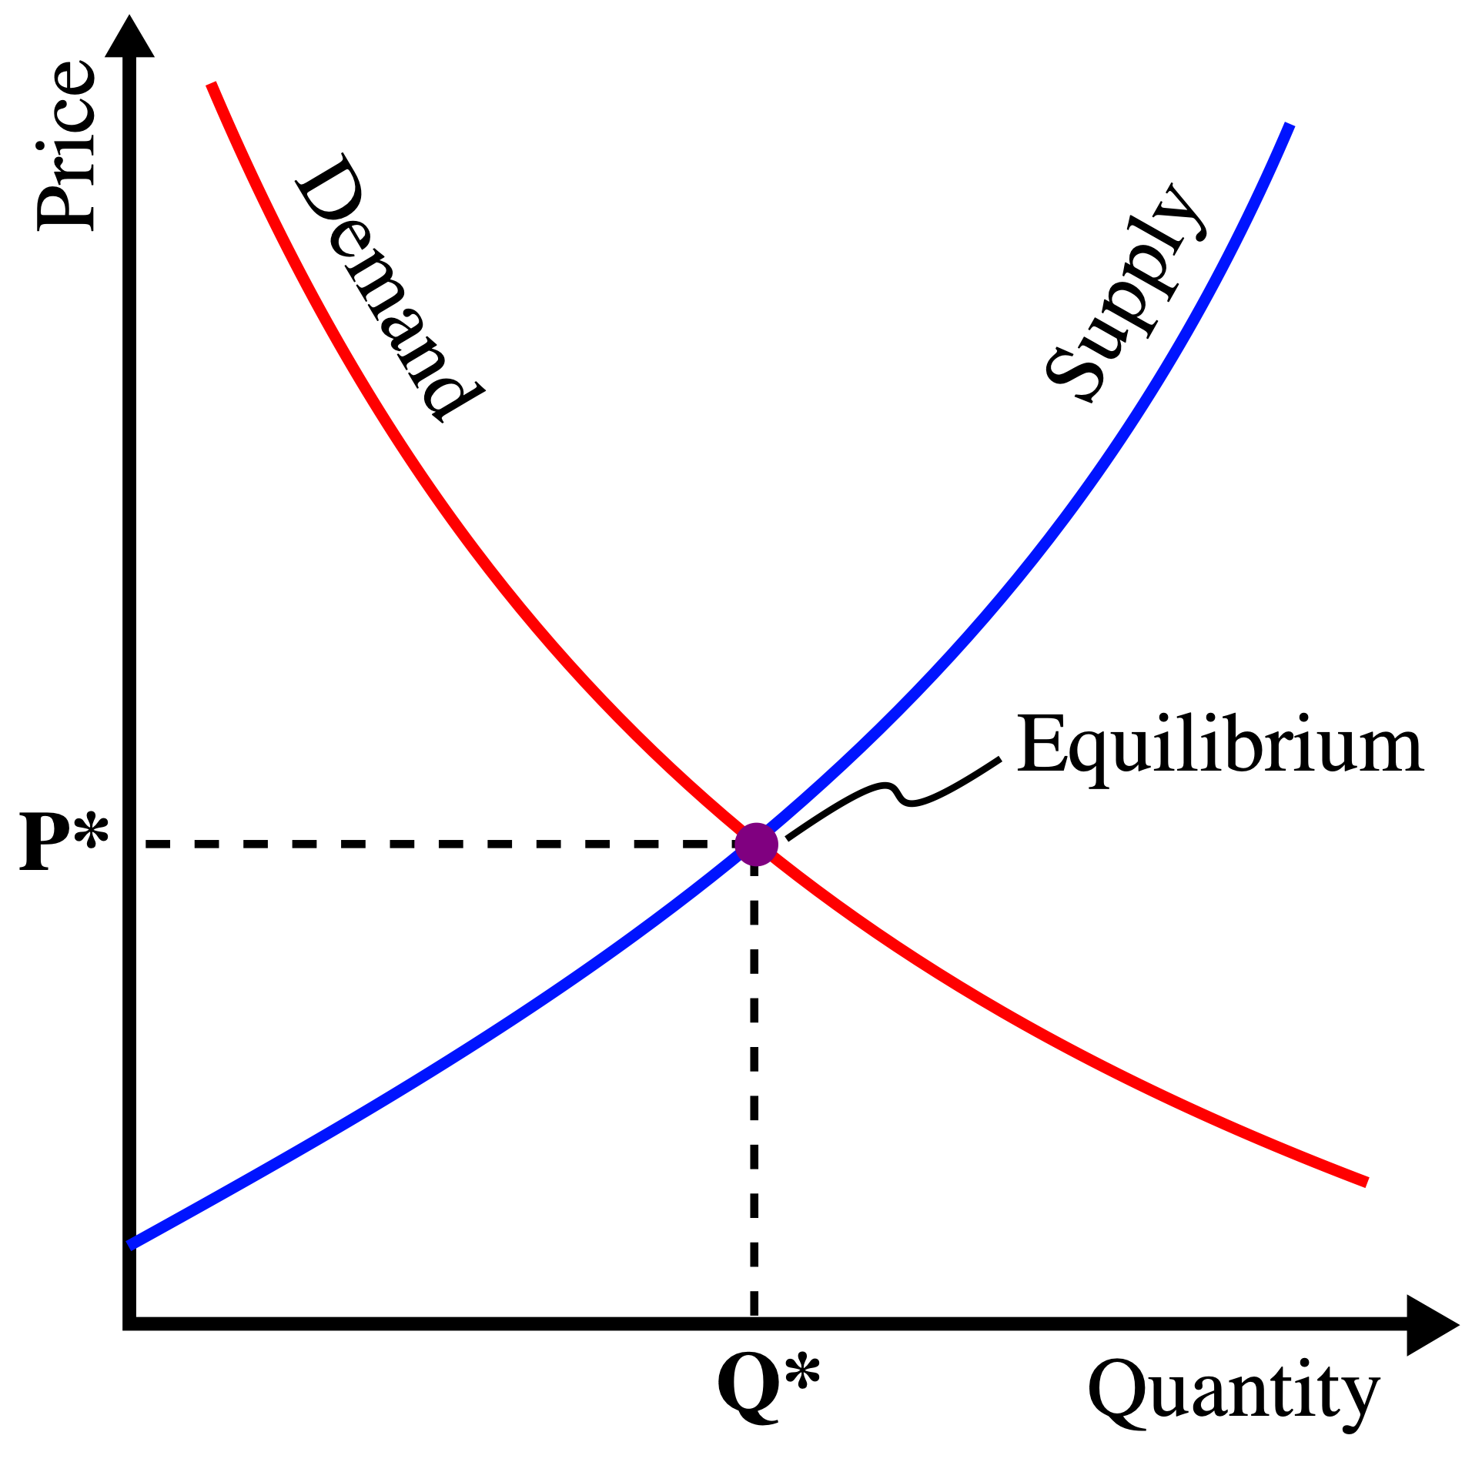
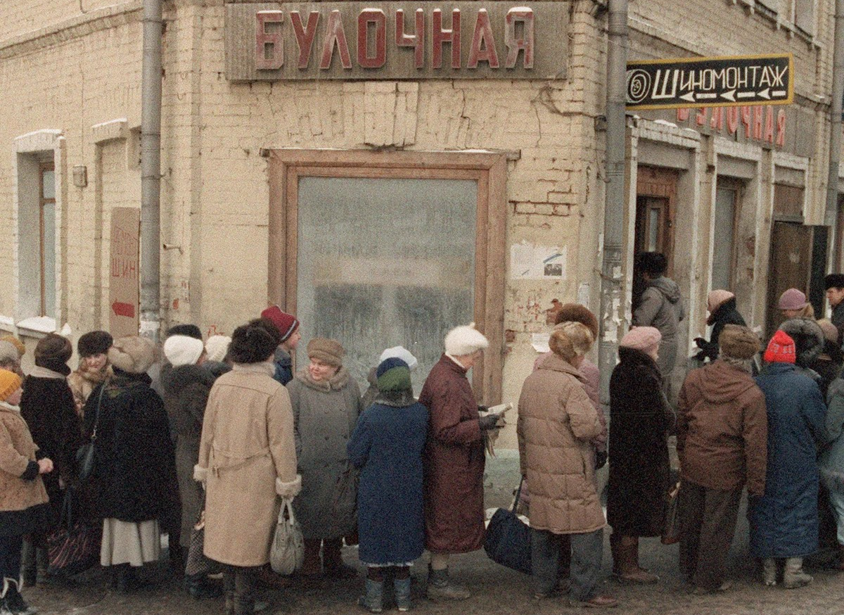
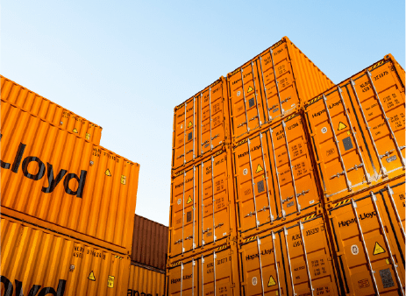
Notes:
Firstly, about supply and demand.
Demand is how needed a product is (red line in the picture).
Supply is the quantity in which it is available (blue line).
If you are in great need of any item, you will be easily paying a high price for it. And vice versa. You would never pay a lot for a common thing. The same mechanism applies to any commodity.

Slide 4
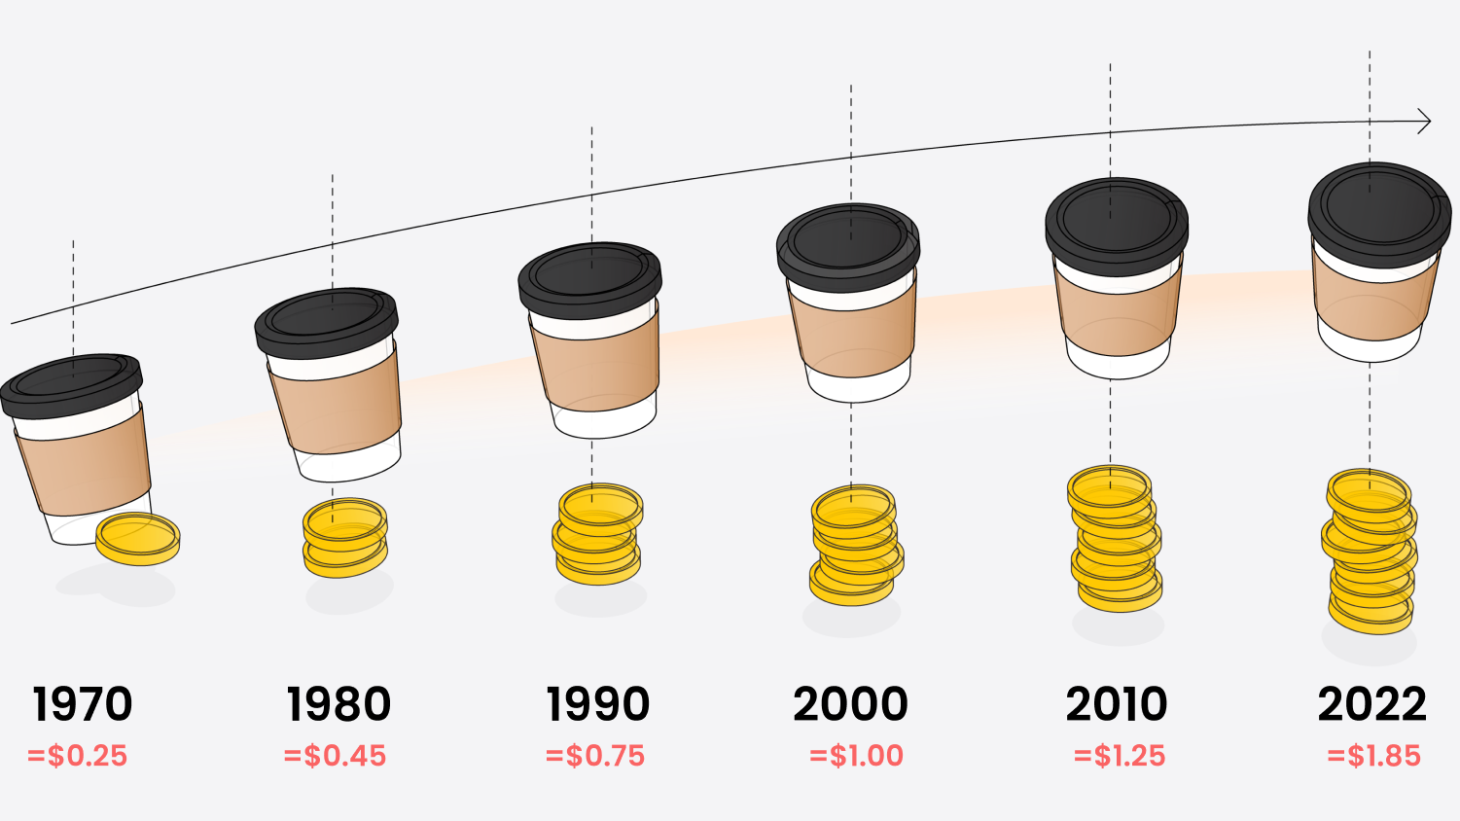
Notes:
Second mechanism is inflation.
For the same amount of money today, you can buy fewer goods. Modern economists suggest that inflation around 2% is healthy and even good for the economy.
You can feel inflation yourself. An example with coffee is very straightforward; everyone has experienced like that.

Slide 5
Metals🥇🥈
Notes:
So after theory to real-world commodities:
Metals: Gold and Silver.

Slide 6
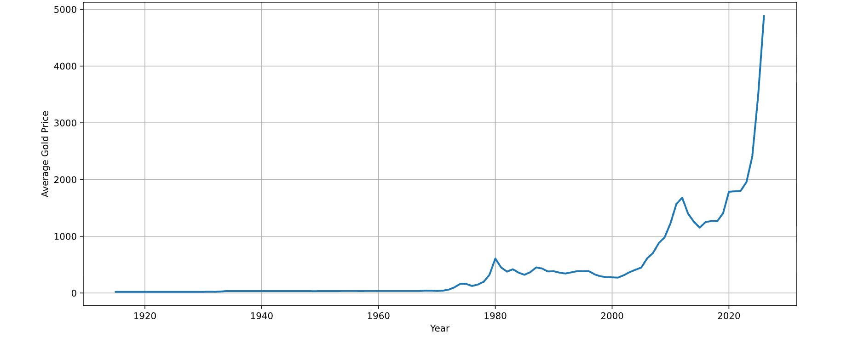
Gold prices over time🥇
Notes:
We have a huge amount of data on gold prices. We have data from 1915.
There is a curious thing about prices till 1975. It is almost a flat line!
⁃Till 1975, gold prices were fixed by the government. So none of the mechanisms we described before were influencing it.
After 1975, gold prices were no longer fixed but determined by the market.
-1980: Height inflation. Reason: investors’ speculative demand.
-2011: Several countries in the European Union were in default. That provoked interest in gold, which increased demand and therefore increased prices.
-2022: After COVID inflation, global crisis, wars. All this provoked a huge spike!

Slide 7
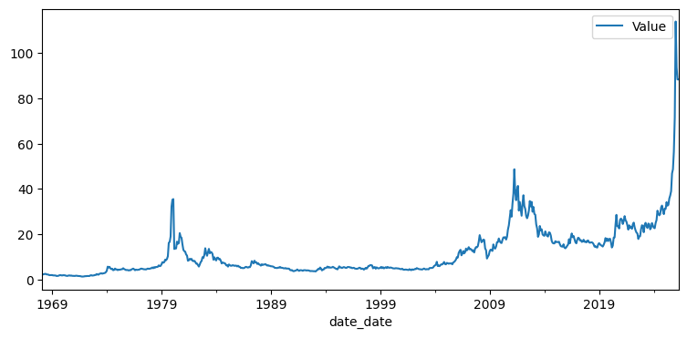
Silver prices over time🥈
Notes:
Silver copying trends of gold prices, with one small exception.

Slide 8
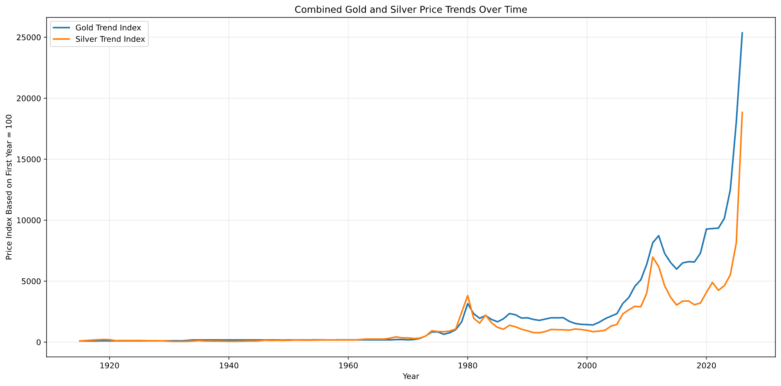
Notes:
On this slide, you can easily see that gold and silver prices are rising and falling together.
But the silver index is usually lower, with an exception around 1980.
Around 1980, a spike in silver was provoked by Hunter Brothers; they got 70% of the world’s silver and speculated on the prices.

Slide 9
Oil🛢️
Notes:
Let us see what was happening with oil prices through all those years.

Slide 10
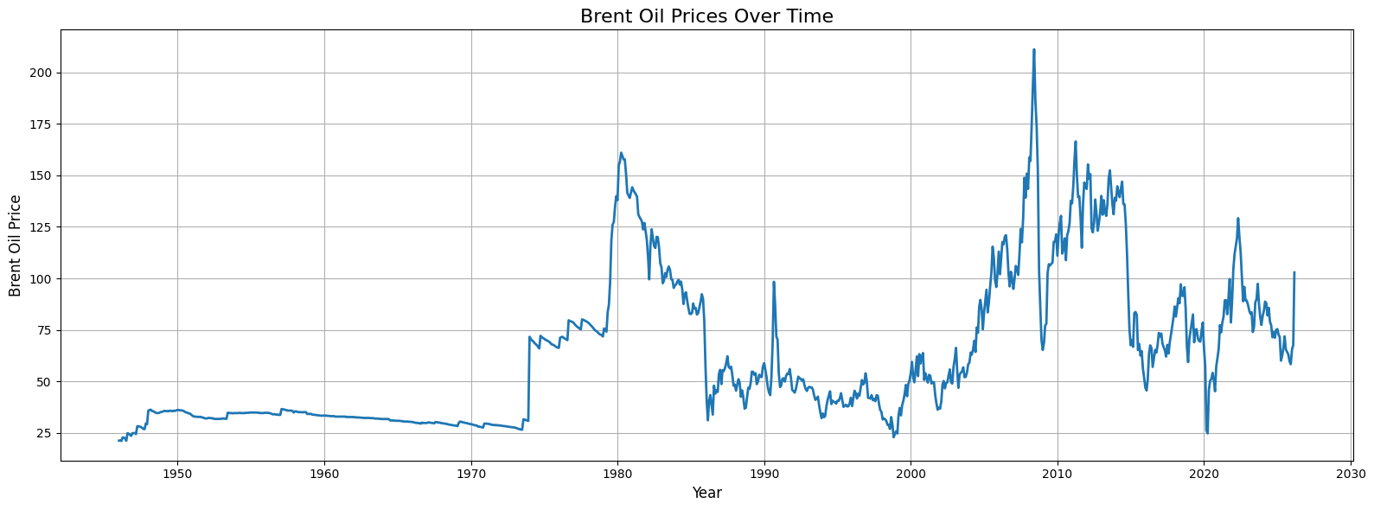
Brent Oil prices over time🛢️
Notes:
Oil became an important commodity globally by the 1930s.
For years between 1946 and 1973, oil prices remained stable; the world was rebuilding itself after WW2.
In 1973, OPEC countries proclaimed an oil embargo. It created a huge demand, and therefore prices rose.
In 1980, the Iran/Iraq war decreased oil supplies again, which increased prices even more.
In the years from 1980 to 1998, market adjustments and lower demand reduced prices.
1999 to 2008: Great years of globalisation. Global demand and economic growth increased oil demand, which, as a result, increased prices.
2008-2009: Global financial crisis reduced demand and, as a result, prices.
2010-2014: Prices recovered after the financial crisis.
2014-2016: Oil oversupply caused a major price fall. OPEC has a mechanism to regulate oil prices by setting a maximum limit of oil production.
And now to the most recent observations:

Slide 11
The most recent observations
Notes:
The most recent observations covering the past five years.

Slide 12
Notes:
2020 - COVID-19 reduced global oil demand. People were locked at home. Lower demand for gas for all types of transport.
2021-2022 - Economic recovery and supply issues increased prices. In 2022, oil prices rose. The The Russia/Ukraine war caused a 30% spike.
Four years later in 2026, oil prices rose again because of the Iran/USA war. The war caused a 60% spike.

Slide 13
Notes:
After 2020, gold prices started rising as an answer to uncertainty connected to trading wars, COVID-19, and actual physical wars between countries.
Metal prices stay a commodity for those seeking stability.

Slide 14
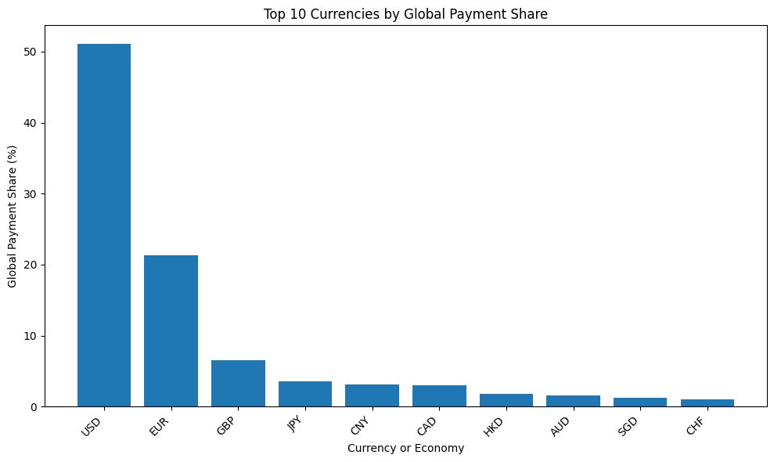
Notes:
Crypto and other currencies as dollar alternatives are experiencing increased demand in recent years.

Slide 15
Investment strategy A
(short term)
Notes:
And now to the most important part. To prognosis.
We came up with two investment strategies. Short term and long-term.
These strategies could not be considered as individual investment recommendations.
And one more important announcement here. We provide our answer to the question “What to buy now?”.
Investors should not forget about diversification. We provide our view only on the main asset in the portfolio.

Slide 16
Currancies
💵 💴 💶 💷
Notes:
Highly volatile markets can provide great profit in the short term.
For now, USD is still a reserve currency. So it is considered to be relatively stable.
Here are the risks. The dollar must be monitored closely. After a new reserve currency occurs, the dollar will lose its value swiftly as it happened with all the previous reserved currencies before it.

Slide 17
Investment strategy B
(long term)
Notes:
Next strategy is for long-term investments, 5-10 years and more.

Slide 18
Metals as main asset
🥇
Notes:
In all the time gold prices were rising a bit faster than inflation. So it is a great choice for defending your money against it.
The main risk is the very high price now and a risk of further decrease in price in metals.

Slide 19
Investment strategy 0
(for all times)
Notes:
Diversify your investments.
It is especially important in hard times, as right now.
Investors should maintain diversified portfolios across different asset classes and geographic regions. A combination of equities, gold, and other assets can help reduce exposure to currency fluctuations and geopolitical risks.
Companies with global operations may provide additional resilience during periods of economic uncertainty.

Slide 20
Thank you for your attention!
❤️
Notes:
Thank you for your attention!

